Slide 1

Event Processing Course
Lecture two –
Principles and architecture
(relates to chapter 2)

Slide 2
Lecture highlights
Event based programming
Main concept
Model driven engineering approach

Slide 3
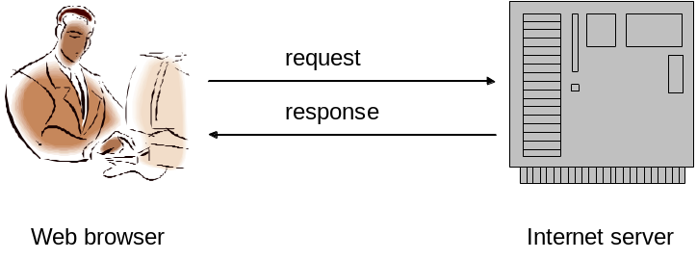
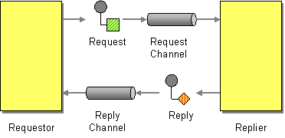
Request-Response
An event is an indication of something that has already happened whereas a request,
as its name implies, expresses the requestor’s wish that something specific should happen in the future.
As a result we use slightly different terminology for the participants in an interaction involving events. Instead of talking about a service requestor and a service provider, we refer to an event producer and an event consumer.
Taken from
http://www.eaipatterns.com
Based on the Enterprise
Integration patterns book by
Hohpe and Woolf
Synchronous interactions
In a synchronous interaction the provider is expected to send a response back fairly promptly.
This usually means a few tenths
of a second at the longest, though response times of several seconds are
sometimes encountered in web applications.
The requestor's thread of execution blocks waiting for the response to arrive without doing anything else in the interim/

Slide 4
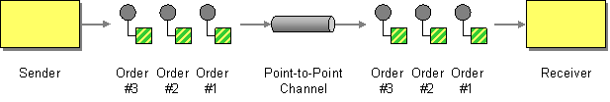
Point to Point
Taken from
http://www.eaipatterns.com
Based on the Enterprise
Integration patterns book by
Hohpe and Woolf

Slide 5
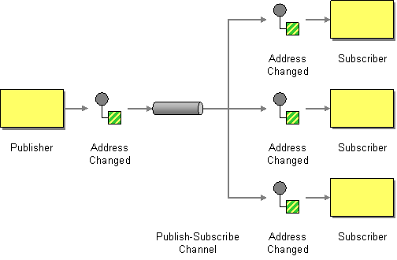
Publish-Subscribe
Taken from
http://www.eaipatterns.com
Based on the Enterprise
Integration patterns book by
Hohpe and Woolf

Slide 6
Principle of decoupling
In a decoupled Event Processing System an event producer does not depend on any particular processing or course of action being taken by any event consumer.
Moreover an event consumer does not depend on any processing performed by the producer other than the production of the event itself.

Slide 7
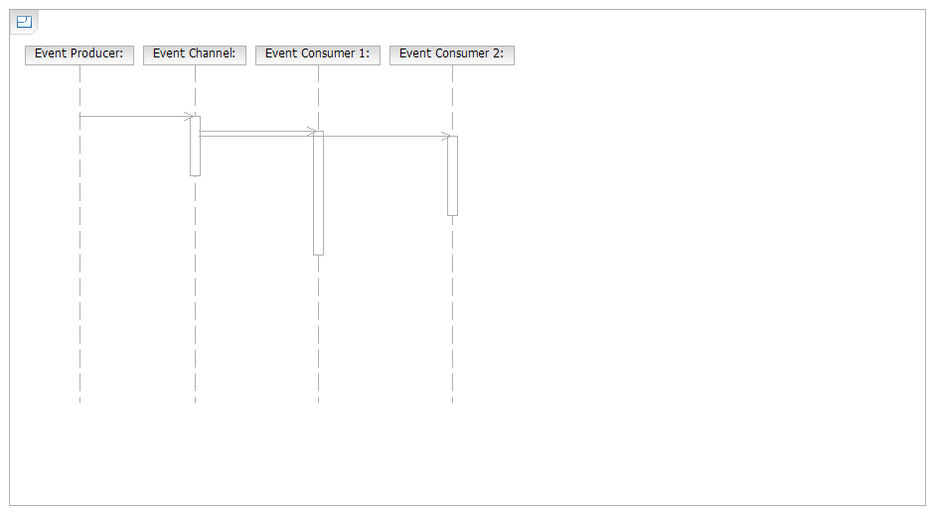
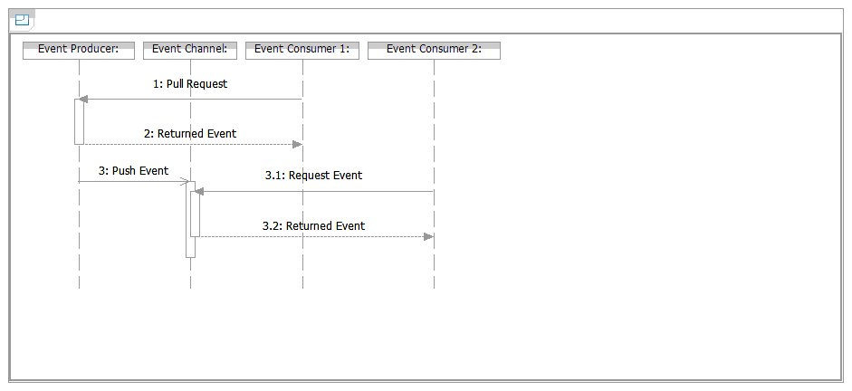
Push vs. Pull

Slide 8
Event vs. Message
There’s one area of possible confusion that it is worth clearing up at this stage, and that is the distinction between an event and a message.
Message passing systems are often used to distribute events between event producers and event consumers, and it’s tempting to equate events with the messages used to transmit them.
The difference here is that the event is the entity that records information about the event occurrence, whereas the message is the mechanism used to exchange that information.
There are messages that don’t contain events, and conversely you can have events that aren’t in the form of messages (for example event records held in an event log).

Slide 9
What Makes EDA Different from Traditional SOA?
Event-based programming, also called event-driven architecture (EDA) is an architectural style in which one or more components
in a software system execute in response to receiving one or more event notifications.
In Event-Driven Architecture (EDA):
Events are always pushed, not pulled.
The timing of the event message is determined by the source (event server) not by the event consumers.
The event source and the event object never specify what action the consumer will perform — the consumer determines the operation.
Not all Event Processing is EDA:
Event objects may be transmitted in a request/reply message pair (for example, RPC).
Or event objects may be at rest in a database or file (used, for example, in a BI database query).
Notes:
Tutorial/Background: Event-driven architecture (EDA) is an architectural style in which one or more elements (components) of the application execute in response to receiving one or more event objects in the form of a message (a notification).
A message containing an event object (i.e., a notification) is different from a remote-procedure call (RPC) or service invocation because a notification does not specify the name of a method or operation to be performed by the recipient (the event consumer). This has huge implications because it helps to decouple the source and consumer from each other. An event consumer can change or additional event consumers can be added without affecting the event source in any way. (However, a change in the event source may disrupt the event consumer so even an EDA system is not totally uncoupled.) The consumer decides whether to run, when to run and how to function based on its own internal rules acting on the attributes of the incoming events. By contrast, in an RPC or method-centric type of SOA, the consumer and service provider must agree on the operation that will be performed.
EDA may use simple events, complex events or both. However, not all event processing is event-driven (EDA). For example, although CEP is usually EDA, it can run offline by analyzing log records or computing on events at rest in a file or database. Online analytical processing (OLAP) and other business intelligence (BI) techniques are often applied to event data (including complex event objects), but they are generally not event-driven in their mode of operation.

Slide 10
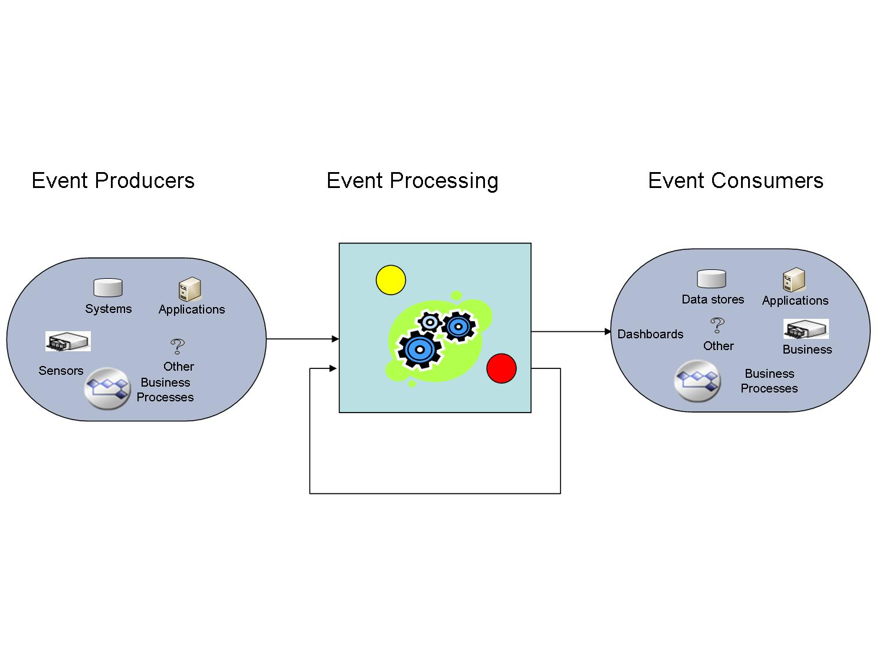
Main parts of event processing system

Slide 11
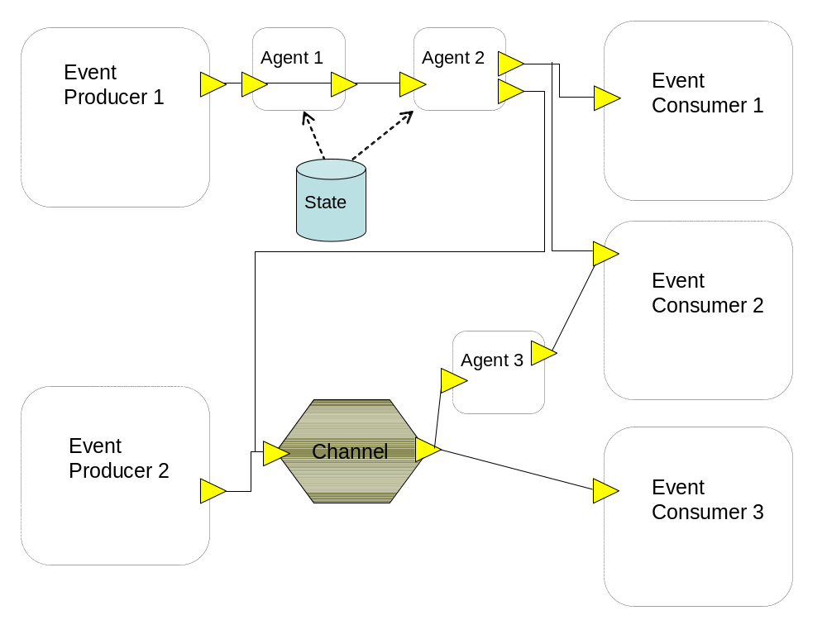
Event processing network

Slide 12

Event Stream
An event stream is a set of associated events.
It is often a temporally totally ordered set (that is to say that there is a well-defined timestamp-based order to the events in the stream).
A stream in which all the events must be of the same type is called a homogeneous event stream;
a stream in which the events may be of different types is referred to as a heterogeneous event stream.

Slide 13
Event kinds
Raw event: An event that is introduced by an external producer
Derived event: An event that is produced by the event processing system
Note that this definition is relative!

Slide 14
Stateless event processing
The simplest form, also known as Event-Condition-Action
An event is being processed individually, but no state is being kept
Stateful event processing
The processing involved more than one event
State:
  Keep the input events in a state
  Keep incremental impact

Slide 15
Event Type
Building Block
Platform
Independent
Creator for
Platform Independent Definition Elements
Translated to
Platform Specific Definition Elements
Platform
Specific
Run-time Instance
Specific Definition
Elements Instances

Slide 16
Event Type
Building Block
Platform
Independent
Creator for
Delivery Request Event Type
Translated to
Delivery Request Event Type
(an event schema of product X)
Platform
Specific
Run-time Instance
Delivery Request 3329
From the Great Flower Shop

Slide 17
The seven
Building blocks
Event
Channel
Event
Producer
Event
Type
Event
Consumer
Context
Event Processing Agent
Global
State

Slide 18
Event Processing Agents
Event Processing Agent
Filter
Transform
Detect Pattern
Translate
Aggregate
Split
Compose
Enrich
Project

Slide 19
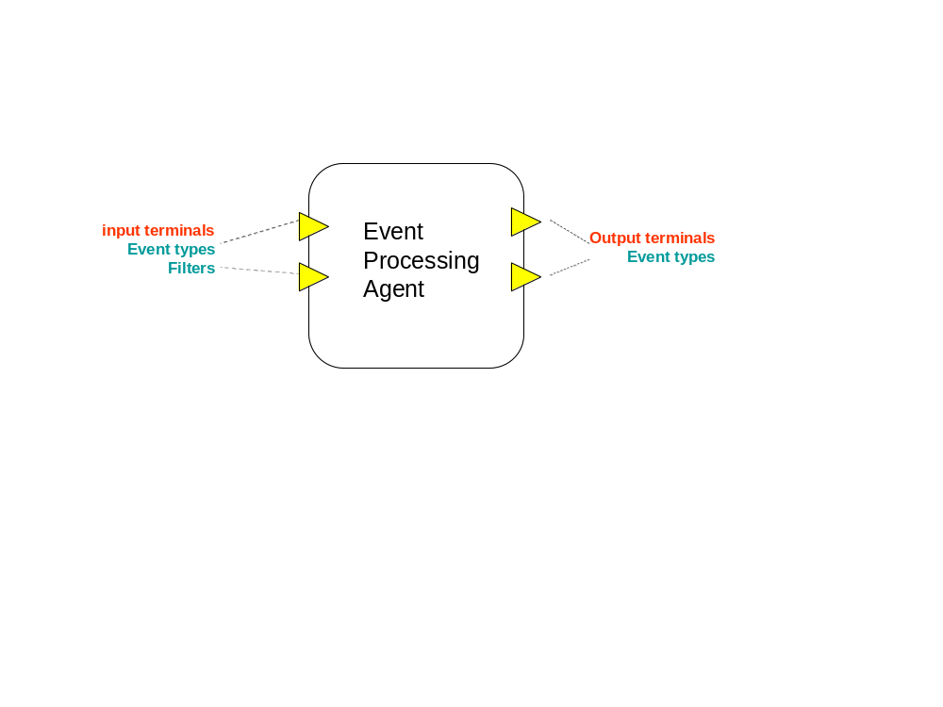
Some constructs

Slide 20
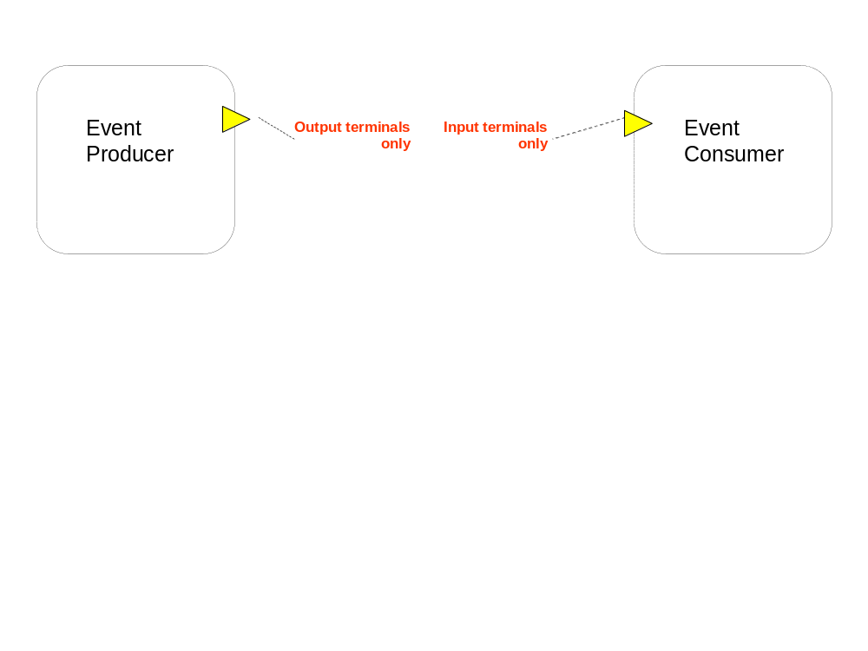

Slide 21
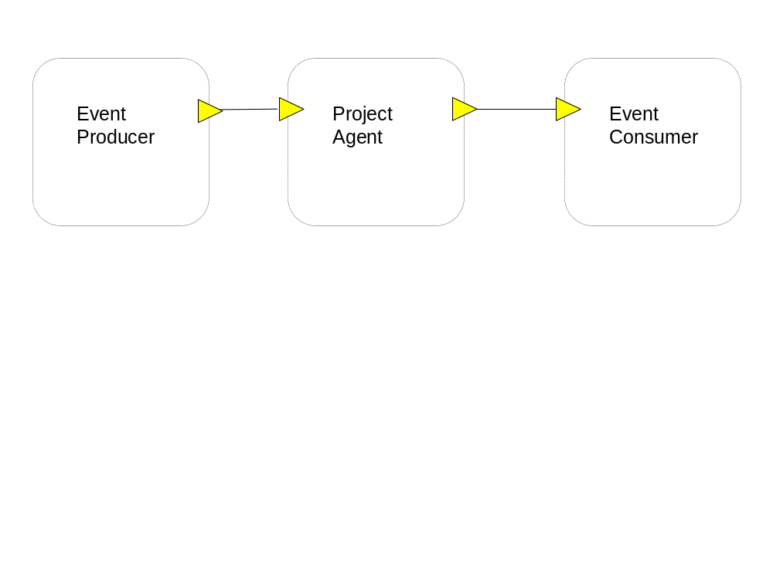

Slide 22
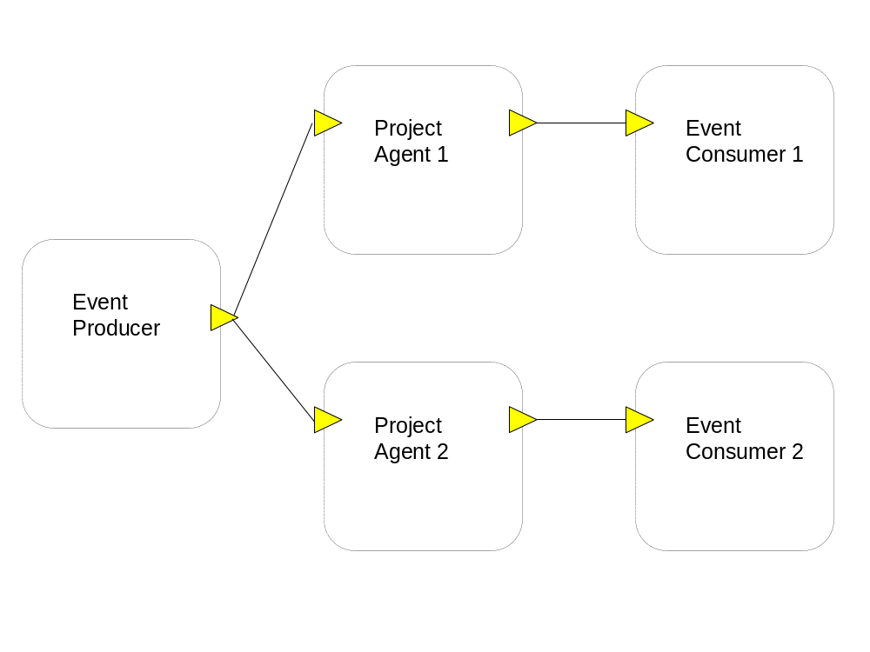

Slide 23
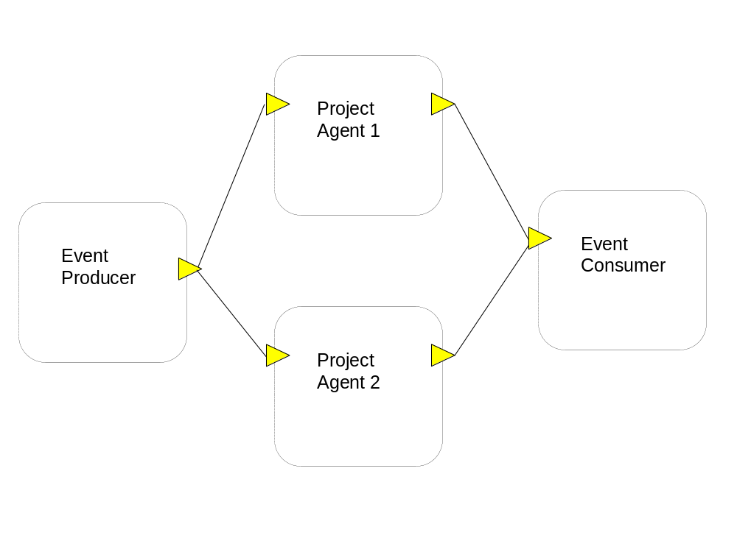

Slide 24
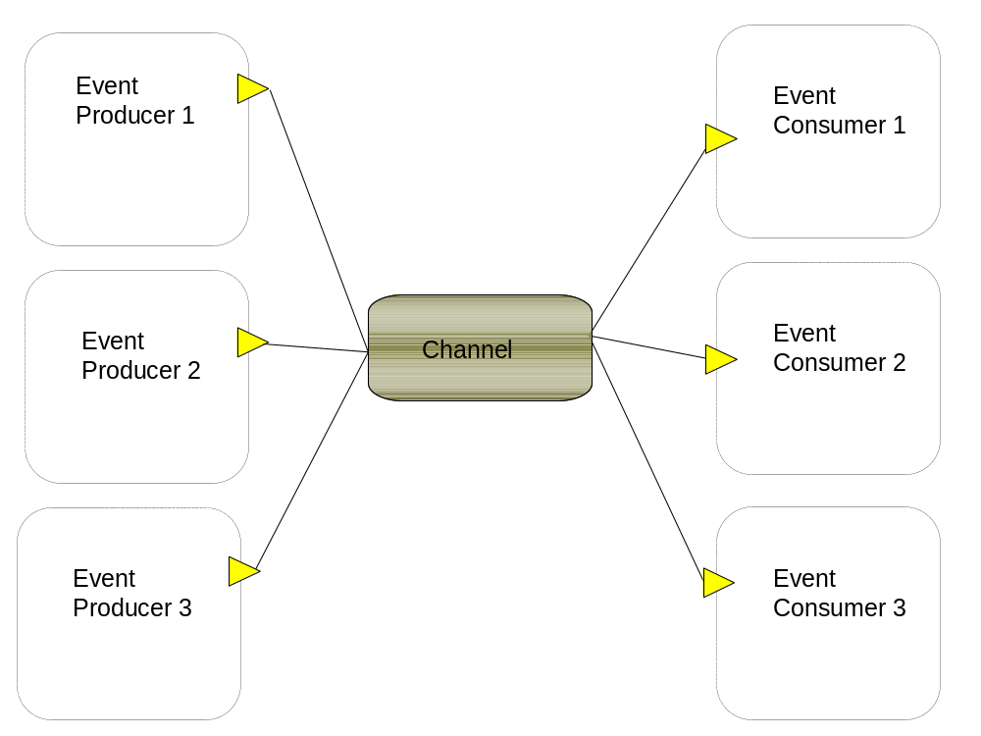

Slide 25
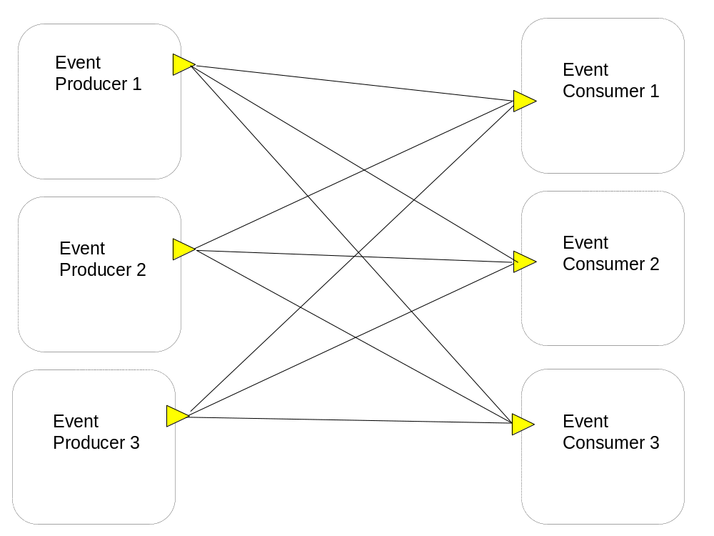

Slide 26
Lecture Summary
In this lecture we have discussed the following topics:
  Event-driven architecture and principles
  Model driven approach and major building blocks

